Slide 1
Evaluating Voxel Drawing for Virtual Reality Environments
Honours Thesis Presentation
Johna Latouf
Notes:
My honours thesis is about the design and testing of a voxel drawing application for virtual reality
I’ll start by talking a bit about the background and purpose of this study and then I’ll describe the development of the system and study and the results of the user study

Slide 2
Introduction
Virtual Reality (VR) and Augmented Reality (AR) devices are becoming mainstream
Professional artists and designers use 2D desktop displays to create 3D designs
Depth cues, orthogonal views to supplement true 3D visuals
Keyboard/mouse or stylus controls limit physical movement
VR’s stereoscopic display provides true 3D visualization
VR controllers and body tracking provide a full range of motion
Notes:
VR devices like the Oculus and Vive are entering mainstream in gaming, education, and conferences
Most professional artists still use traditional desktops and tablets for design work
I was a professional graphic artist before coming to dal, and we generally used keyboard, mouse, and Wacom tablets
But vr now offers true stereoscopic 3d environments
There are a variety of control systems for vr now that allow for full body movement, such as Oculus touch and Leap Motion

Slide 3
Introduction
Challenges?
Arm fatigue (gorilla arms)
Physical discomforts
Dizziness
Motion sickness
Hand tracking
Accuracy
Ease of use
Notes:
But with this new technology, we see brand new challenges for developers
Arm fatigue is a big issue with mid air gesture controls
Physical discomfort such as dizziness and motion sickness associated with moving around in stereoscopic displays
Hand tracking with controllers like the leap motion has trouble with accuracy and can be difficult to learn

Slide 4
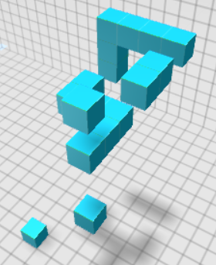
Introduction
Voxel drawing for the Oculus Rift and Leap Motion
Voxels?
Volumetric Pixels
Uniform sized cubes that build a 3D model
“like Minecraft”
Leap Motion?
Figure 1 voxels in Unity 3D
Notes:
This system is a voxel drawing application for the Oculus Rift and Leap Motion
What are voxels? Voxel is a portmanteau of volumetric and pixel. Where pixels form 2d uniform squares that make up a big image, voxels are 3d uniform cubes that make up a 3D model.
But what is Leap Motion?

Slide 5
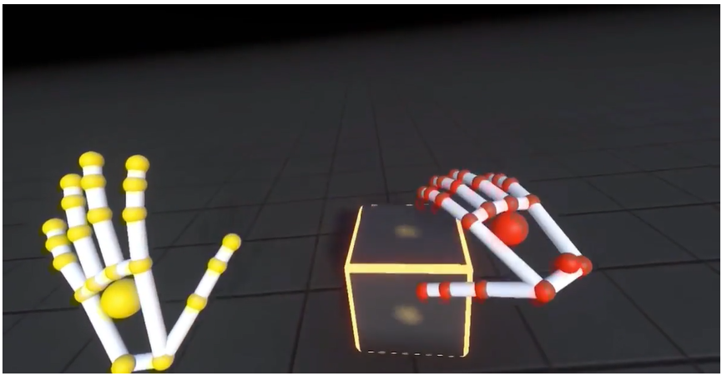
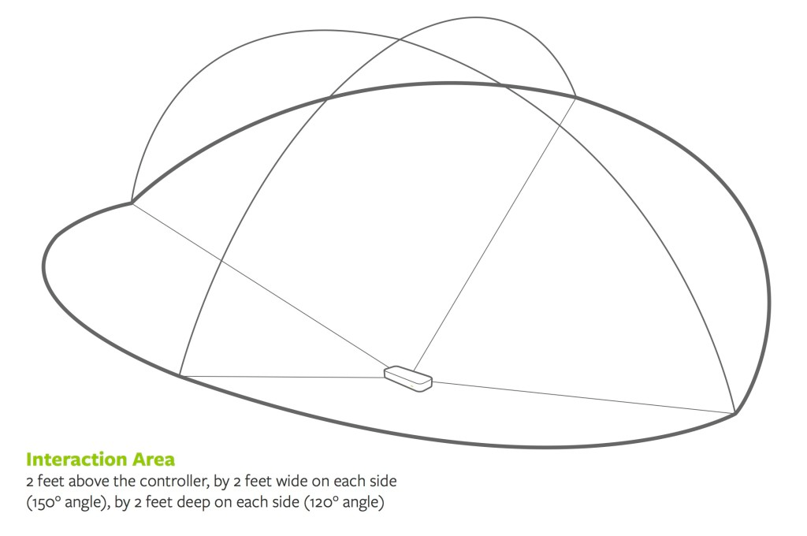
Introduction
Leap Motion is a third party hand tracking system
Desktop and VR use
Uses cameras and infrared LED’s to track arm and hand movement
Builds set of 3D arms and hands
SDK for Unity 3D includes interaction with objects
Figure 2 Leap Motion demo [1], Leap Motion range [2]
Notes:
Leap motion is a third party tracking system that uses cameras and infrared LED’s to track arm and hand movement.
It builds a set of 3d hands in the vr or desktop environment and responds to gestures
And these images show the leap motion hands in a demo application and down here is a diagram of the leap motion device’s field of view

Slide 6
Background and Related Work
Aigner et al. categorize preferred gestures
Grasping/releasing for selection
Pointing to move objects
Gestures also vary across cultures [4]
Desktop Leap Motion modeling app was developed by Cui et al.
Felt natural, but accuracy was lacking
Faster than traditional software [5] [6]
Scanning
Techniques include scanning real objects and editing with mouse [7]
Scanning 2D drawings using hand-held tracking devices and extruding [8]
Procedural modeling
Igarashi and Hughes developed a suggestive interface that allows users to choose from a list of shapes that match touch gestures [9]
Notes:
So a bit of background:
There is some research into the sorts of gestures people are comfortable using in vr and ar environments
There are a variety of projects that make use of the leap motion or other tracking and scanning devices to try and combine true 3D interaction with 3D modeling for 2D desktop displays

Slide 7
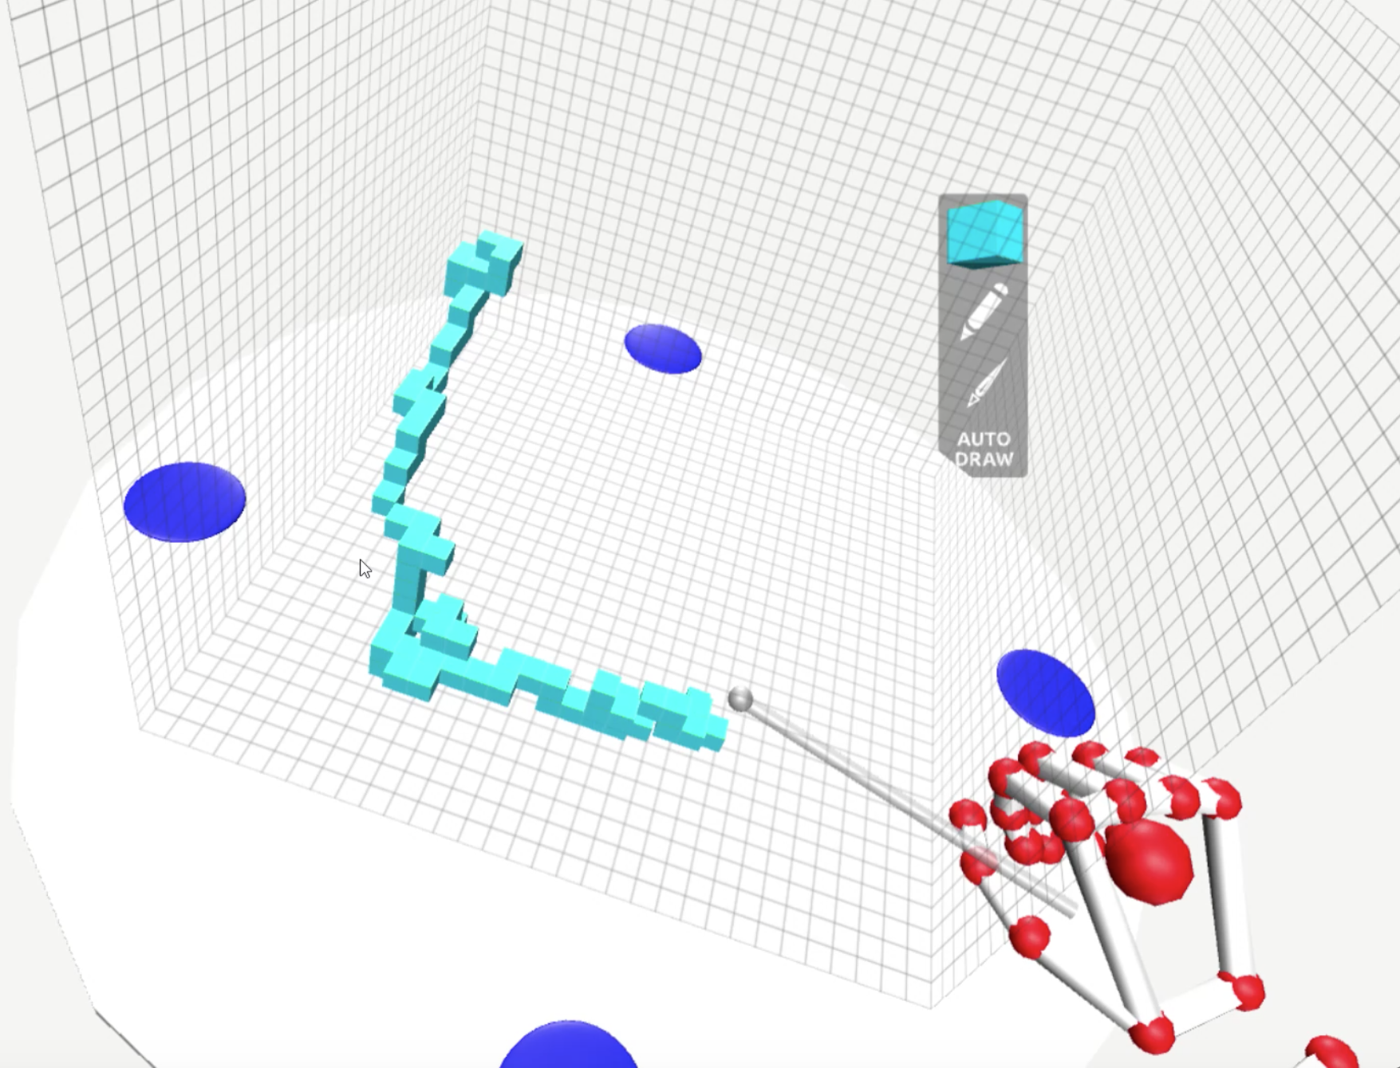
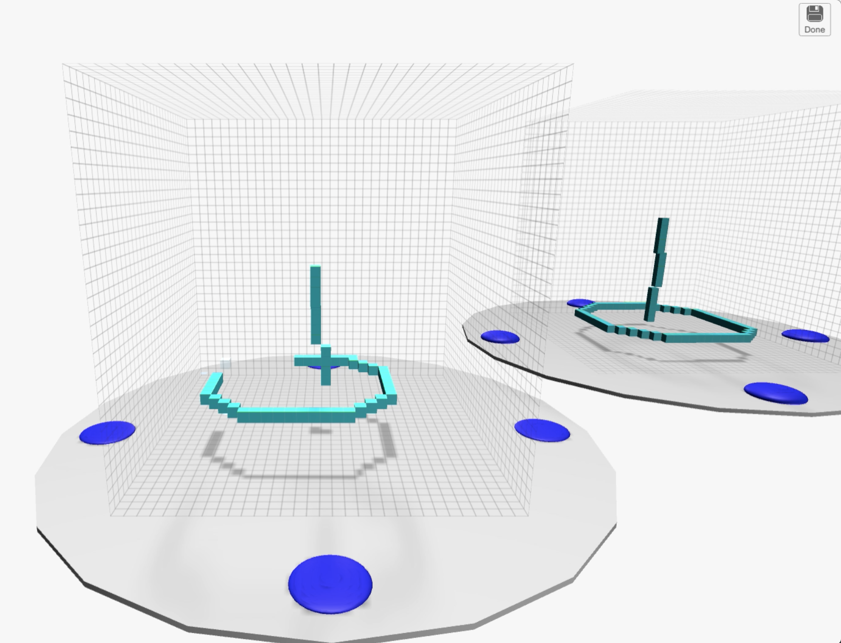
System Design
Unity 3D Game Engine
Oculus Rift SDK and Leap Motion Orion Beta SDK [10]
Two versions for the user study:
VR and Desktop/Keyboard
Figure 3 The desktop and VR applications
Notes:
For the system design:
Developed using Unity and the Oculus rift and leap motion orion beta sdks The system was originally written for VR, but for the purpose of the study a desktop version was created as well
There are also some features that were disabled for the study, but I’ll briefly talk about those as well
And these are screenshots from each version

Slide 8
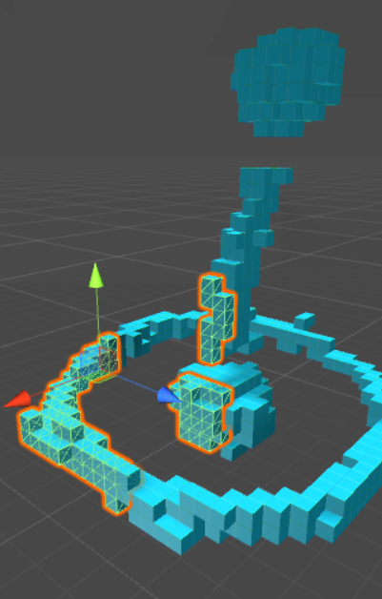
System Design
VR Drawing Environment
Voxel drawing expands voxel terrain system by Alexandros Starvrinou [11]
Voxel model is broken into 16³ “chunks”
Voxels objects are either Empty or Full
Each full voxel uses a marching cubes algorithm to only draw triangles where no full neighbour is present
New Model scene allows user to select 16³ to 80³ drawing, but user study only allows 32³
Figure 4 A selected voxel chunk in Unity 3D
Notes:
For the VR environment:
My voxel mesh drawing scripts expand on a voxel terrain system tutprial written by Alaxandros Starvrinou
Voxel models are broken into 16 cubed “chunks” to accommodate Unity’s triangle limits
In the original terrain system there are all different types of voxels, but for this application there only needs to be Empty or Full type. So when I talk about empty voxels, I mean the empty spaces. A 32 cubed voxel model always technically has 32 cubed voxels in it, even if only a few full voxels have been drawn.
Alexandros’s system uses a marching cube algorithm to check for non-empty voxels on all sides of existing voxels to determine where to actually draw mesh. This prevents unnecessary triangles.
4096
32768
For the study, everyone uses a 32 cubed voxel, but the system is designed such that users could select dimensions of multiples of 16 up to 80 for every side

Slide 9
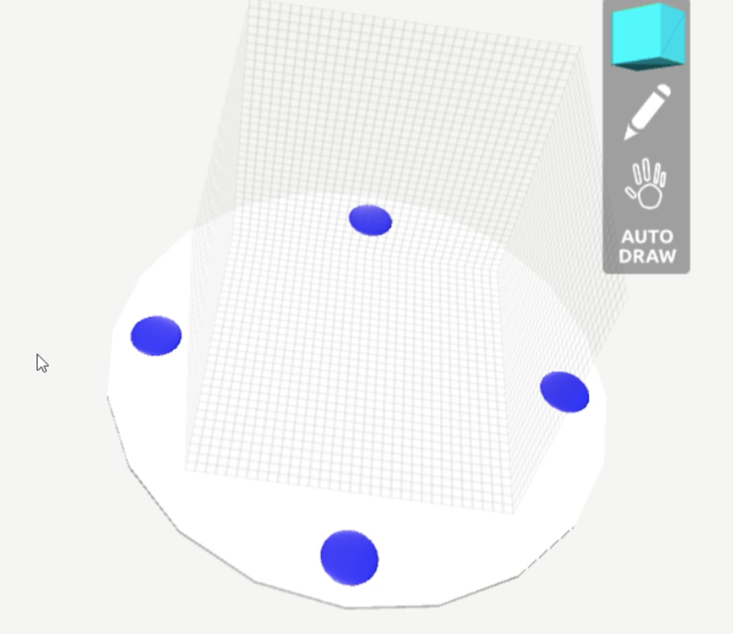
System Design
Voxel model is placed on a disk-shaped platform and surrounded by a grid
Four “handles” on the platform for interaction
Grasping a handle moves the platform
Flat palm on handle rotates platform
Figure 5 The VR drawing platform
Notes:
So this set of 32 cubed voxels makes up a drawing canvas, essentially and in the drawin environment this canvas is indicated with a set of walls that include a tiled grid texture that updates according to canvas dimensions
And all of that sits on a movable platform
The platform has four handle buttons. Grasping the handles moved the platform and a flat palm rotates the platform. Scaling was available but was disabled for the study.

Slide 10
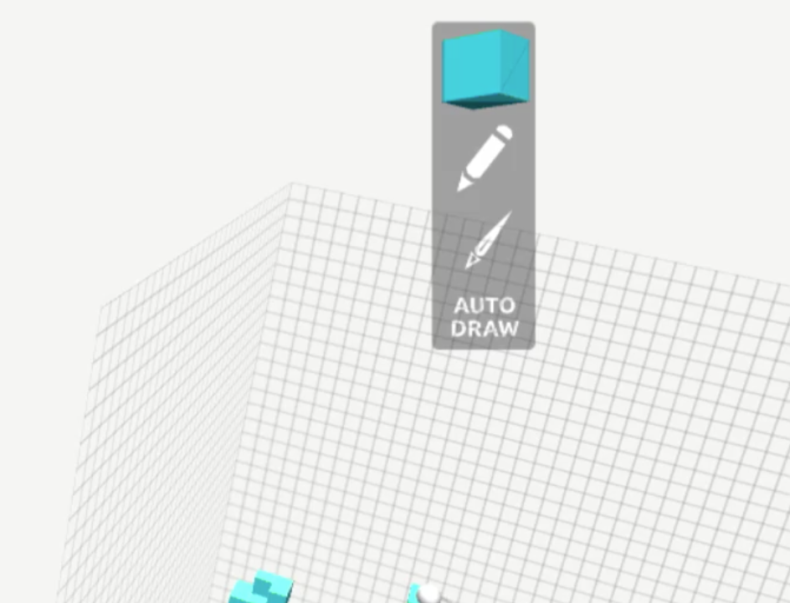
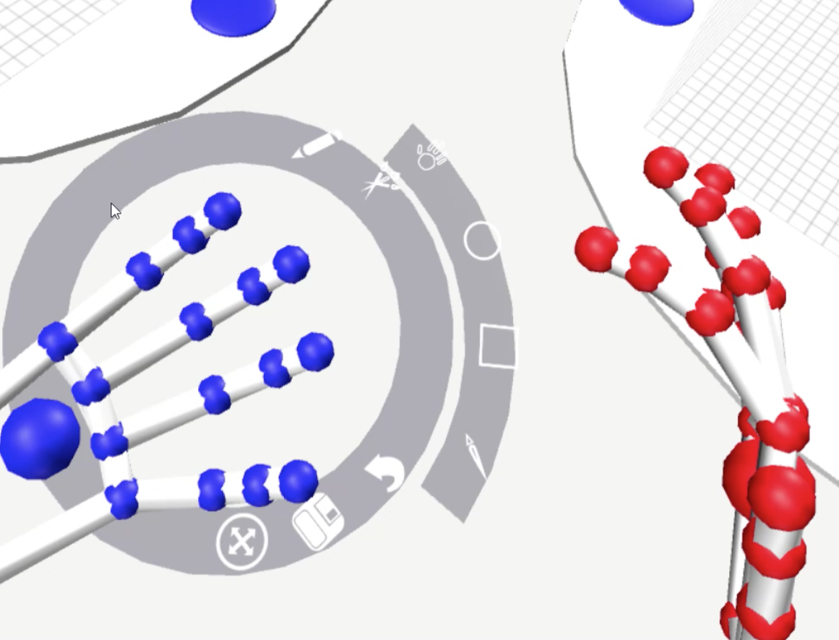
System Design
VR User Interface (UI)
Uses Leap Motion Palm UI Pivot animation and Interaction Button
Circular menu appears on left hand when palm faces camera
Icons are pressed with right hand to open sub-menus or perform functions
Heads Up Display (HUD)
Rectangle that sits out of reach, moves with view
Displays selected color, draw mode, selected brush
Figure 6 The VR HUD and hand menu
Notes:
There’s two main UI elements. One is the handheld menu which attaches to the leap motion hand and appear when the pallm of the eft hand is facing the user.
The Head’s Up Display or HUD sits in the distance and is attached to the camera, so it provides information like the selected colour, draw mode, and brush

Slide 11
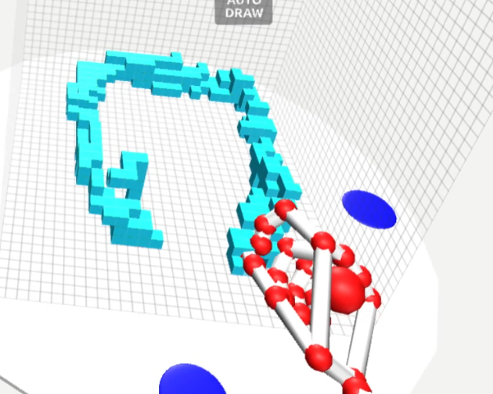
System Design
VR Drawing
Leap Motion’s pinch gesture measures pinch strength from 0 to 1
0.8+ indicates a pinch
Drawing stroke begins when pinch starts, ends when pinch opens
If pinch detector object is located within voxel, the voxel type changes
Figure 7 drawing with the pinch gesture
Notes:
Drawing is done with pinch gestures
Leap motion measure pinch by strength and pinches are detected as 0.8 or above in this application which is the leap motion’s default measurement.
A stroke starts when a pinch starts and ends when a pinch gesture ends. I use this to place strokes on the undo stack.
Using Unity, when a pinch is detected and the pinch detector is in the position of a voxel, the voxel type is changed.

Slide 12
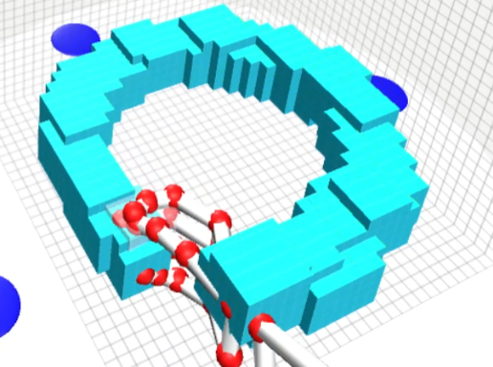
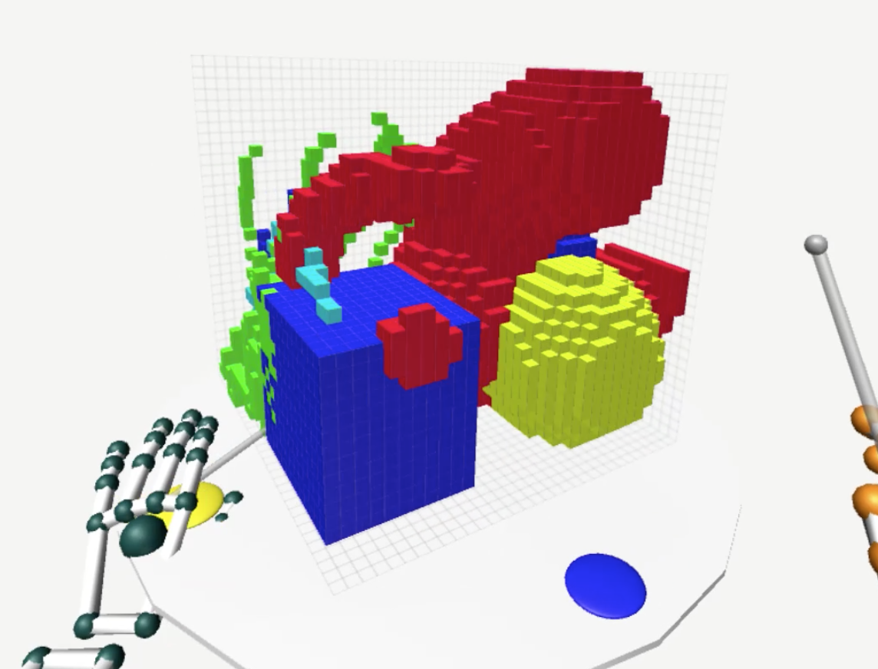
System Design
VR Brushes
Sphere, cube, pen
Sphere and cube – voxels within brush shape are edited
Pen – voxels touched by pen tip are edited
Draw and delete modes
Painting and selecting
Disabled for user study
Painting changes texture coordinates assigned to voxel
Selection adds voxel to selection List object
Figure 8 Drawing with the cube brush, painting with different colours
Notes:
Besides drawing individual voxels with the pinch gesture, there are some brush options, and you can see the cube brush being used in the top image there. The sphere and cube are used to draw groups of voxels within them, and there is a pen brush, which draws single voxels, but it draws them on the end of a stick
Painting and selecting were both disabled for this study, but they are in the system. The colours ooptions for the voxels are all on one texture and the texture coordinates are stored in the voxel object

Slide 13
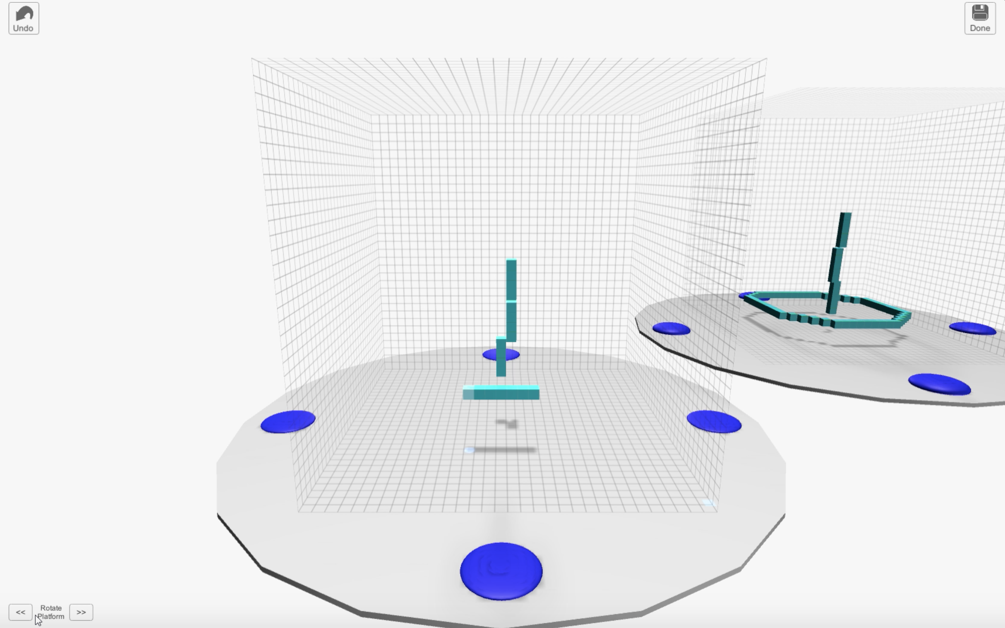
System Design
Desktop/Keyboard drawing environment
Model, grid, and platform
The platform does not move
Platform is rotated using 2D UI buttons
Rotates at 45 degree angles
Figure 9 The desktop application
Notes:
Used the grid and platform, but simplified
Platform is stationary and rotates at 45 degree angles
Everything runs using keyboard and mouse

Slide 14
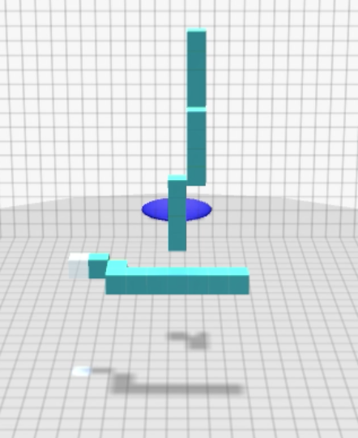
System Design
Desktop/Keyboard Drawing Tools
Add/Delete single voxels
Cursor moves with WASD keys and mouse wheel
Cursor indicates position in Z axis with spotlight
Figure 10 Drawing in the desktop application
Notes:
In this app, there are no brushes, only a single cursor and hitting the space key either adds or deletes a single voxel
The cursor is moved using the WASD keys and the mouse wheel for up and down
And the cursor has a little spot light attached to it that helps indicate depth

Slide 15
Research Methodology
Research Questions:
Do users experience arm fatigue or discomfort with a 3D work area that can be moved and rotated?
Do the drawing options in this application provide enough precision to draw a voxel model that matches a reference voxel model presented to the user?
Are the gesture-based user interface and canvas controls easy to understand and use?
Do users find the application useful for creating 3D models and do they enjoy the overall experience?
Notes:
So now I’ll talk about the study design
Here are the research questions, we wanted to know if the application would help with those common challenges like arm fatigue and physical discomfort
Would users achieve a desired level of accuracy and would the app be easy to use?
And would they enjoy using it?

Slide 16
Research Methodology
Tasks
Recreate reference models using VR and Desktop versions
Participants
Students, faculty from Dal and members of the community
Of those that indicated gender – 13 men and 6 women
Of those that indicated age – ranged from 19 to 37
Two indicated left-handedness
Nine had tried a VR device
Ten tried tracking system such as Leap Motion or Kinect
Nine Used their computer for design once or twice a month
Half started with desktop, half with VR
Notes:
The tasks were to recreate reference models for both versions of the application
There were 20 participants recruited from Dalhousie and members of the community. No prior experience was required.
Of the participants who indicated their gender, there were 13 men and 6 women
Of those who indicated age, they ranged from 19 to 37
A few had tried vr devices or hand tracking controllers in the past, but there were no regular users
A few did use their computers for design and visual art occasionally, but no regular artists

Slide 17
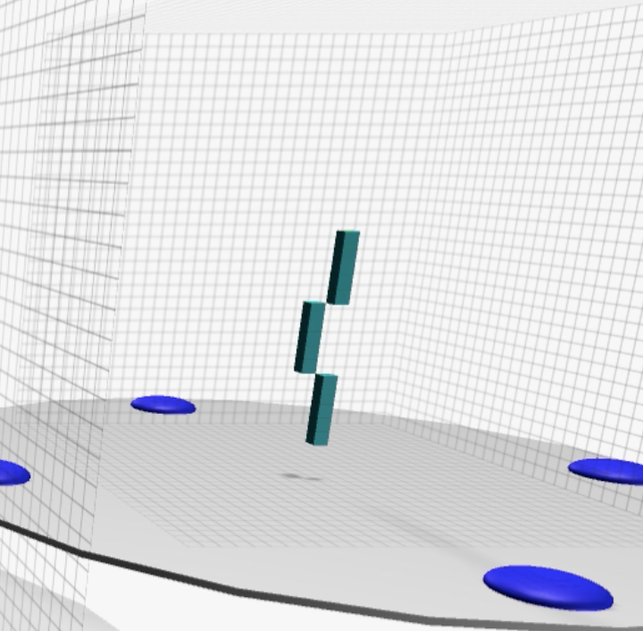
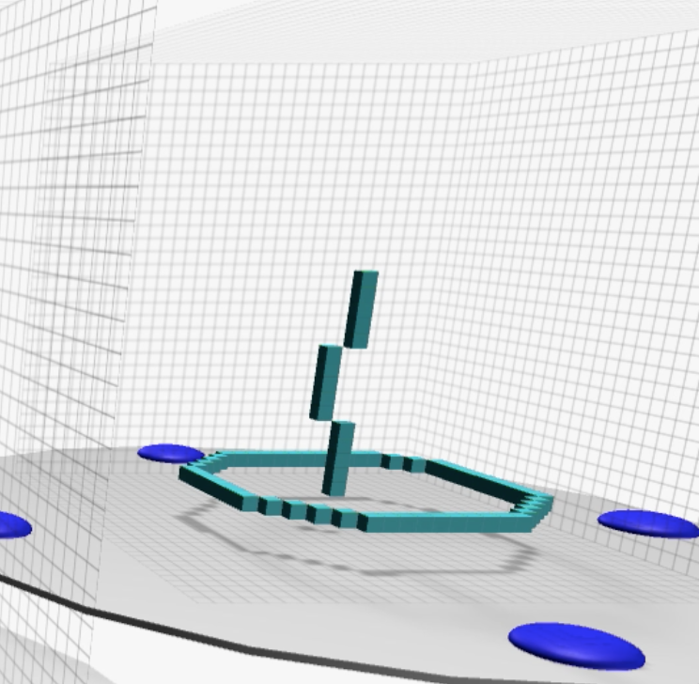
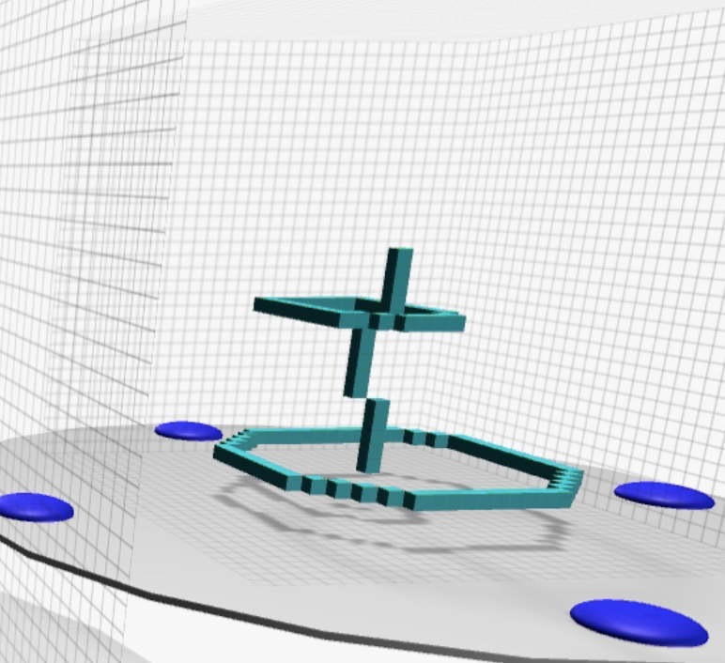
Research Methodology
Desktop/Keyboard Activity
Help account for drawing ability
Instruction and cheat sheet
Reference model presented in 3 steps
Figure 11 The desktop application steps
Notes:
The main purpose of the desktop activity was to help assess drawings made by people who’s drawing skills were unknown, something to compare against because drawing accuracy is dependant both on the application and on user ability
This version included verbal instructions and a paper cheatsheet for the controls
The model was presented in three parts, each time the user recreated one piece, they would click the done button and a new piece would be added, this was to simplify the experience

Slide 18
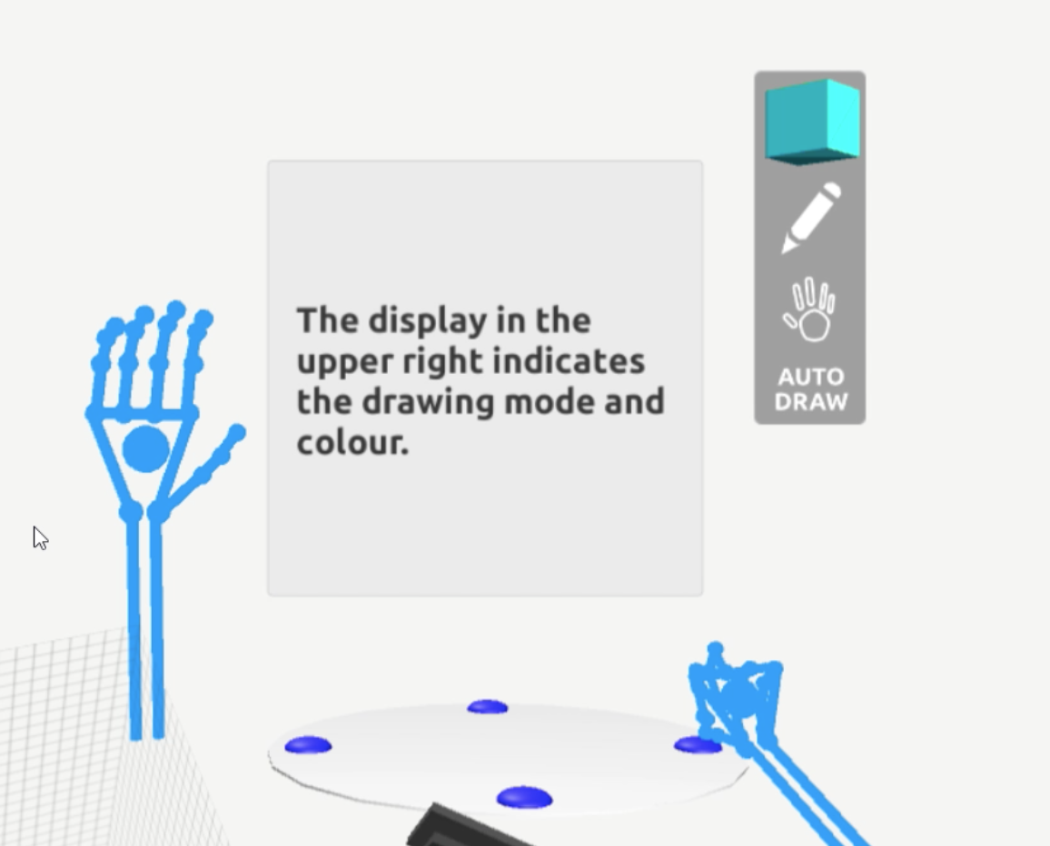
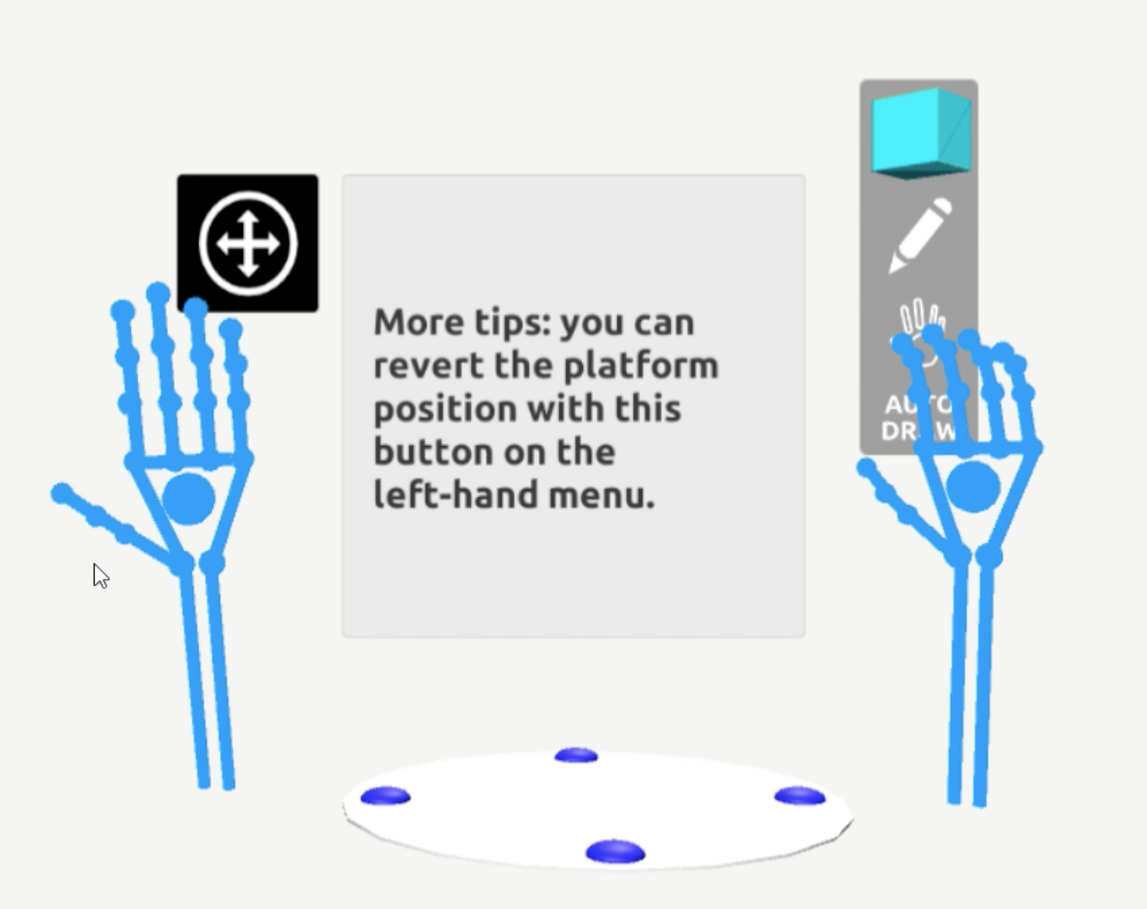
Research Methodology
VR Tutorial
Instructions and help adjusting Oculus
Text based with next and back buttons
A set of animated hands
Figure 12 The VR tutorial images
Notes:
For the VR application, there were two scenes. Before the drawing scene, users were presented with a tutorial.
Before they began the tutorial, I also gave them some verbal instructions and helped them adjust the Oculus an explained the Leap Motion.
The tutorial itself was text-based and included some animated blue hands, that you can see in these screenshots, and it went over the basics very briefly.

Slide 19
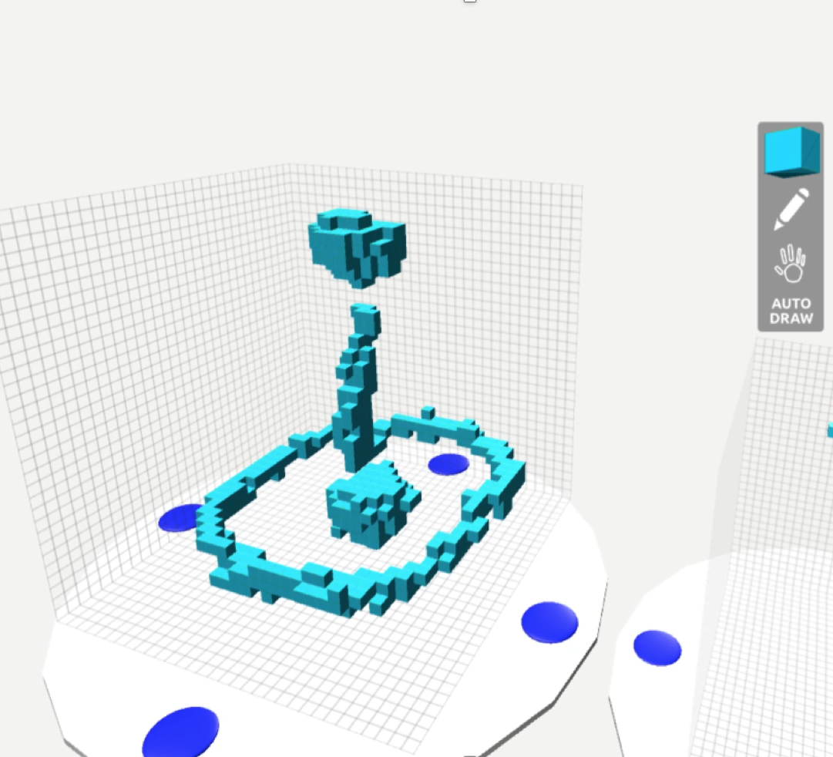
Research Methodology
VR Drawing Task
Reference model on separate platform
Users offered help as needed
Figure 13 The VR reference model
Notes:
In the drawing task scene, they were presented with a single reference model on it’s own platform, both could be moved separately and they were instructed to do their best to replicate the model.
Participants swapped order in which these tasks were done, half did keyboard first, half did vr first.

Slide 20
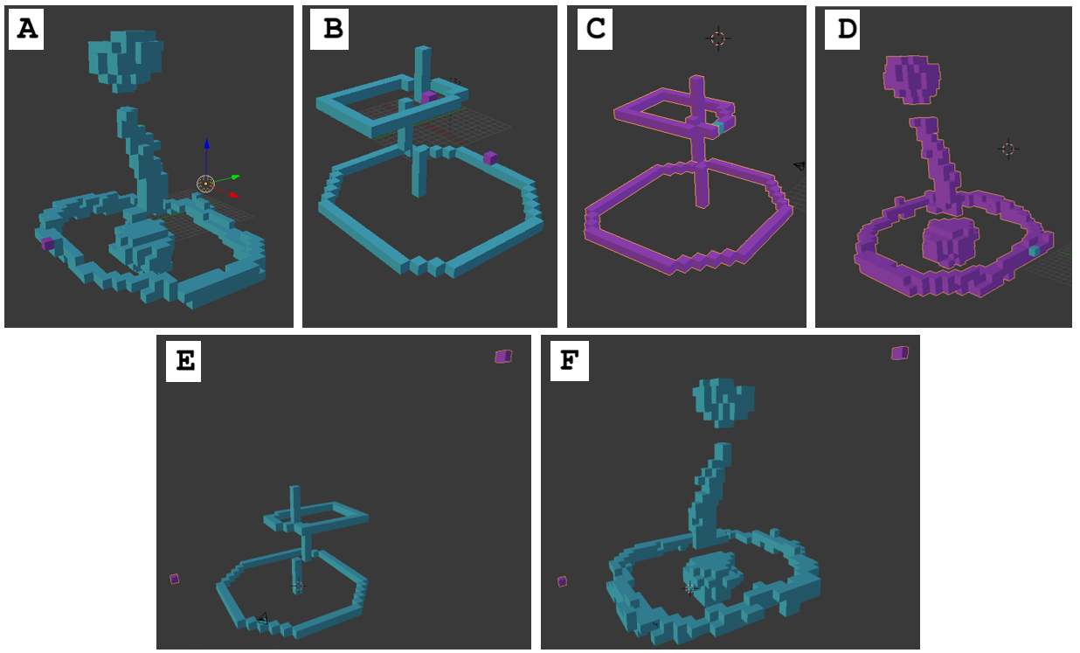
Research Methodology
Analytical Setup
Models assessed for direct voxel to voxel matches
Model shapes assessed using algorithm developed by D. Y. Chen et al [13]
Captures 60 orthographic views of each model and determines dissimilarity score with the sum of the ten most similar views
Figure 14 Slight changes to references models: (A) one addition 516 dissimilarity, (B) two additions 327, (C) one deleted voxel 216 dissimilarity, (D) one deleted voxel 67, (E)two random voxels (purple) against the desktop model 44,158, (F) against VR model 43,670
Notes:
How did I analyze all of these experiences?
First, the models were saved as OBJ files and also printed to binary arrays
The nature of voxels allowed me to make voxel to voxel comparisons, but that can only tell us so much, because it would be easy to make the shape correctly and have it shifted slightly and none of the voxels would match well. That’s where a former student of Dr Brooks came in. She was part of a paper and app development for an app that can assess dissibilarity in 3d model shapes
It does this by capturing 60 orthographic views of each image and calculating a dissimilarity score between each model and sums the lowest ten of those.
This set of images gives an idea of the dissimilarity score range for these reference models. Adding a single voxel or two gives scores of 516, and 327, where deleting voxels causes scores of 216 in C and 67 in D. The highest scores I was able to achieve were using a model of just two voxels placed on opposite corners. This caused scores of 44,158 in E and 43,670 in F.

Slide 21
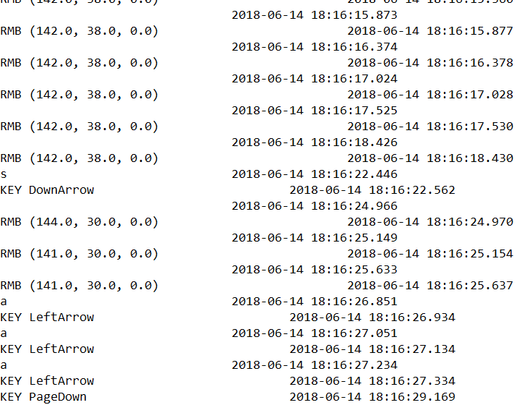
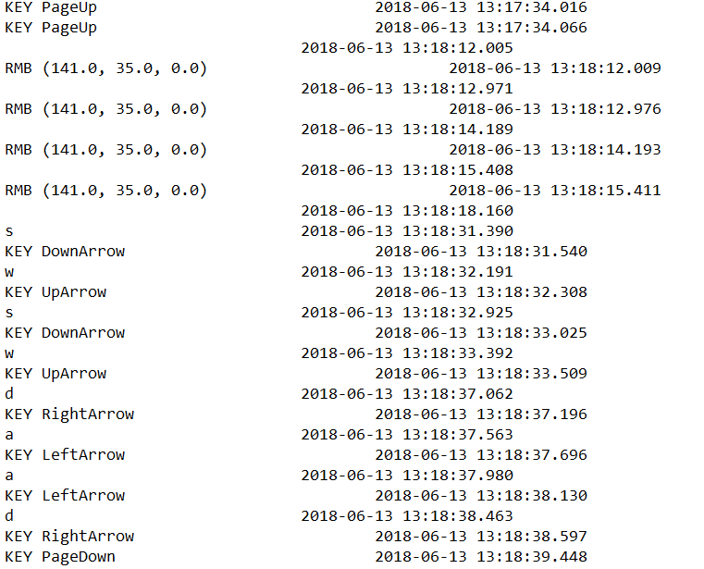
Research Methodology
Analytical Setup
Audio and screen capture recordings with Windows Game Bar
Logs recorded keystrokes in Desktop version and state changes in VR version
Questionnaires with scalar and short answer questions
Scalar questions grouped for version comparison and VR experience assessment
Figure 15 log screenshots
Notes:
On top of assessing the models, there was also audio and screen capture recordings using the windows game bar
And activity logs recorded using C# and Unity
A set of questionnaire questions both scalar question with 1 being strongly disagree and 5 beging strong agree
And some short answer questions

Slide 22
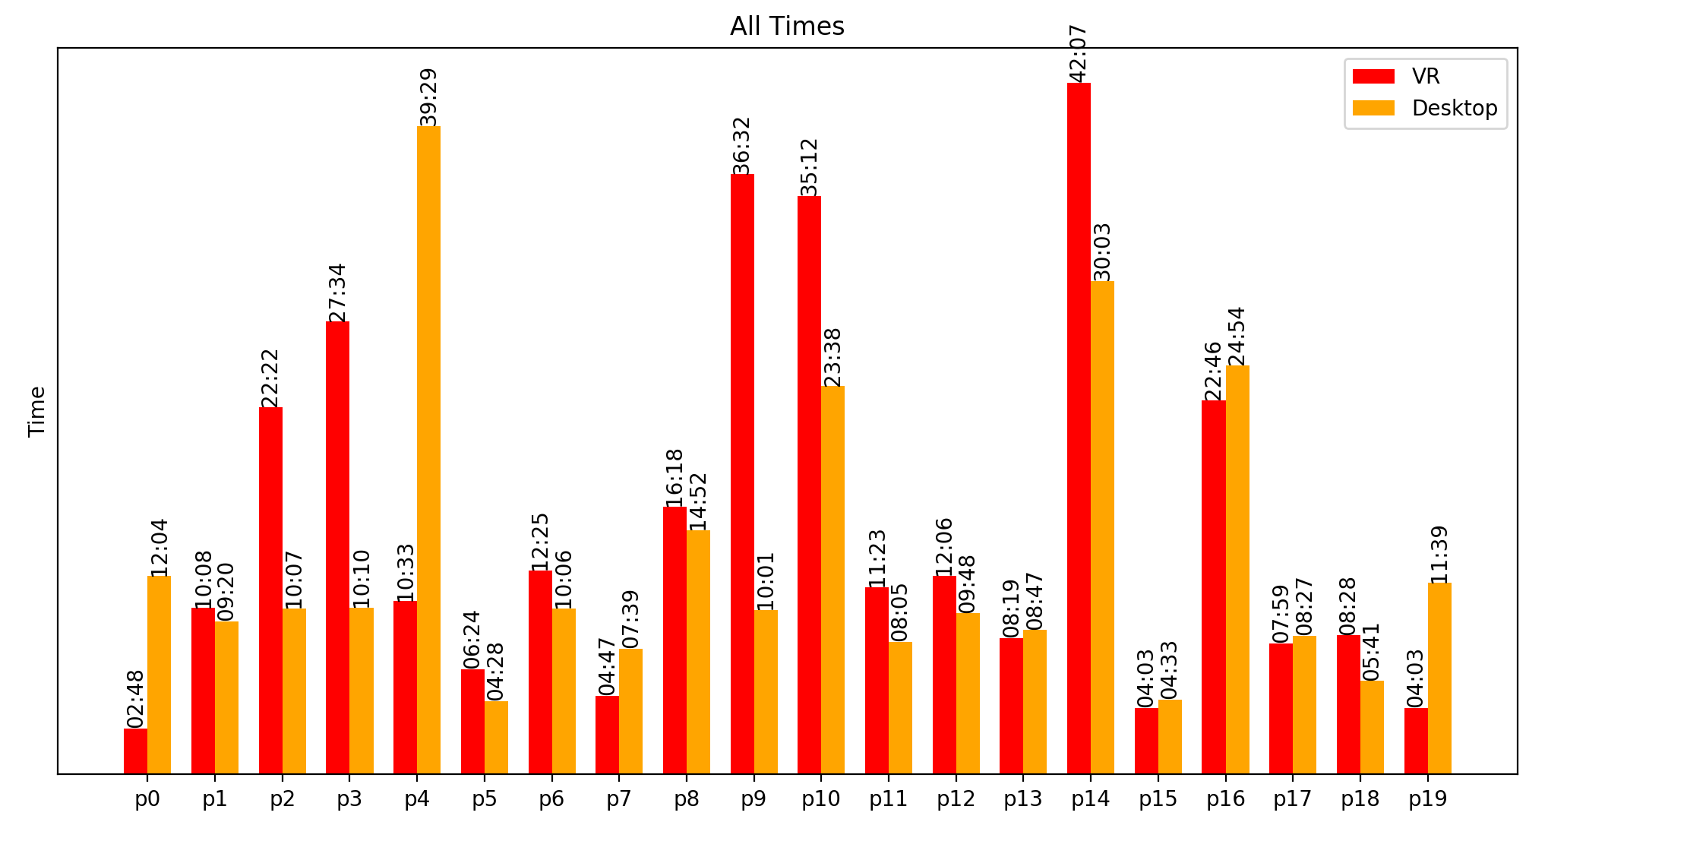
Results and Analysis
Average drawing times:
Desktop 13:12
VR 15:18
Four users preferred desktop, thirteen preferred VR, and two had no preference
Desktop/Keyboard
Users asked for more movement and rotation angles of reference and drawing
Users had the most trouble with the top piece
Users had trouble discerning depth
Figure 16 Individual time spent with the desktop application and in the drawing scene of the VR application
Notes:
Now I’ll talk about the results. I’ll start with some general stats and then go into the desktop and then vr.
Users spent about two minutes more on average on the VR drawing (this doesn’t include time spent in the tutorial) but there are a lot of variations
Most users, when asked to choose a favourite, preferred the VR application
On the desktop application, users asked for more movement options, they had a lot of trouble with the top piece and trouble with depth

Slide 23
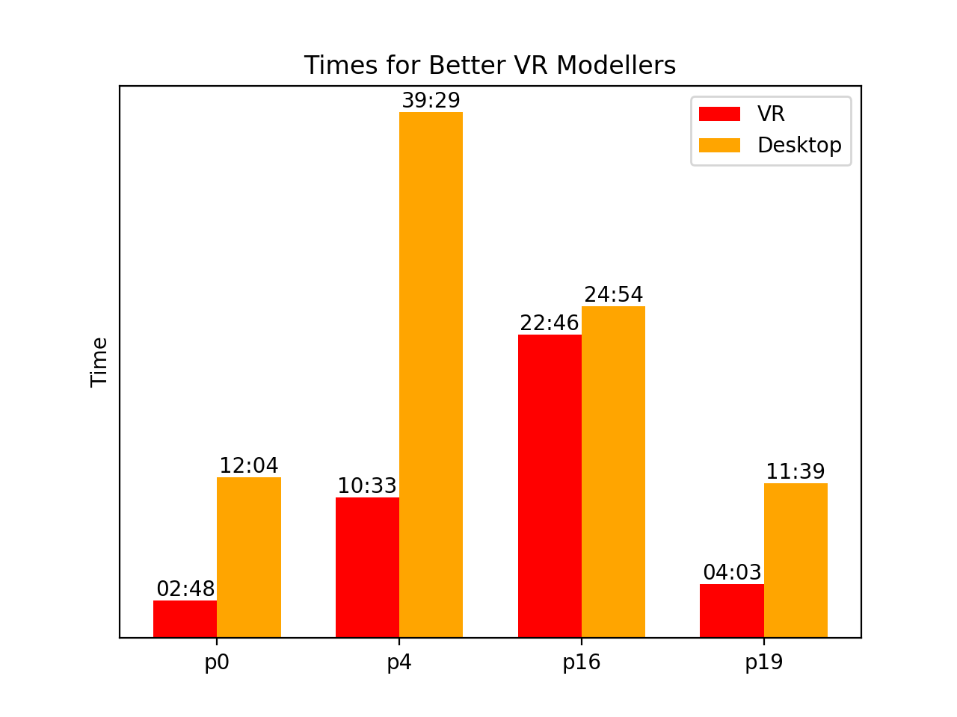
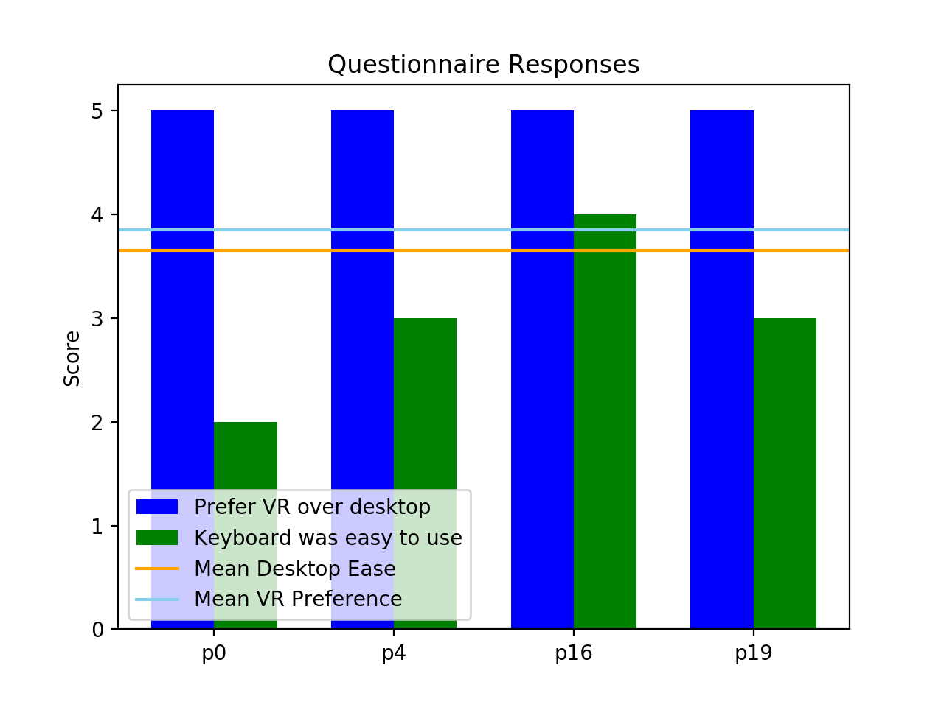
Results and Analysis
Desktop/Keyboard
Four users seemed most frustrated in recording
Spent more time drawing with keyboard than VR
Had higher dissimilarity for desktop model
Strongly preferred VR
“Experiencing 3D in 3D felt more natural”
Figure 17 the times and preferences for users who struggled with desktop
Notes:
There were four users in particular who struggled with the desktop version. They spent more time on the desktop, had trouble with the controls, and their VR models did better in the dissimilarity test (which I’ll talk more about in a minute). Based on their questionnaire answers, they tended to like the vr app better than average and tended to find the keyboard harder to use than average. All of these participants were women, and there were only sixe female e participants, based on conversation in the audio logs it seems these users had less experience with wASD keyboard gaming controls than the others

Slide 24
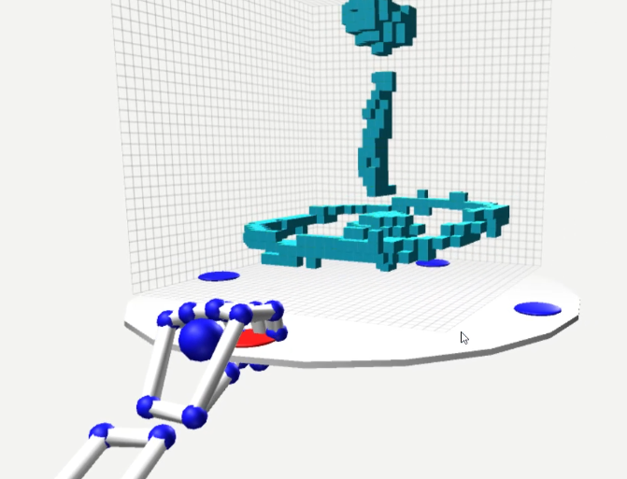
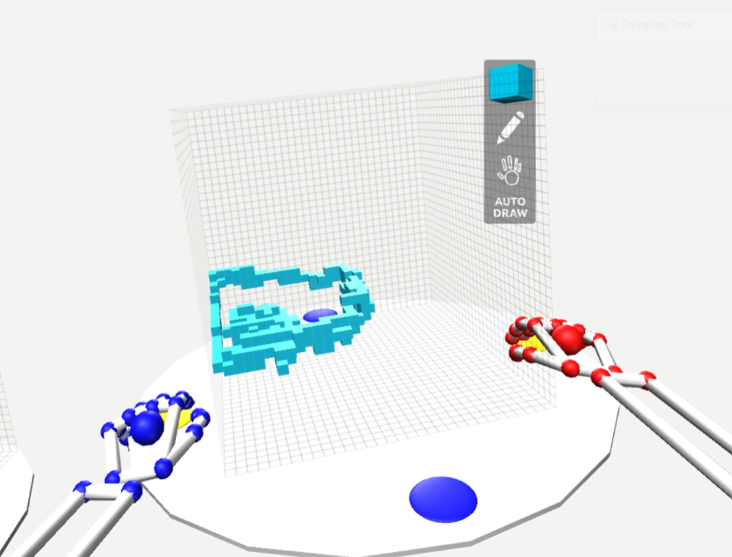
Results and Analysis
VR Tutorial
Not very effective, more explanation was required
Most participants either got ahead of the steps or had trouble following
Some users had trouble pressing Next and Back buttons
VR Platform
Everyone struggled with grasping gesture
Triggering radius around buttons is too small, highlight colour is too sensitive
Half of participants used two hands to move platform or tried pushing it from center
Figure 18 A successful grasp and move and an unsuccessful grasp with two hands
Notes:
The VR tutorial was not very effective. I ended up giving verbal tips to pretty much everybody.
Most participants either got ahead of the text or just got confused or stuck.
And for some the buttons didn’t really work.
For the vr platform, everybody struggled with grasping to move the platform. They rotation was a little easier, but the grasping radius around the buttons was too small, or they were having trouble starting and ending the grasp in a way that was recognized and the highlights were too sensitive and gave false positives.
A lot of users also tried moving with both hands, even though the tutorial only showed one hand, or they tried pushing the disk around, rather than grasping.

Slide 25
Results and Analysis
VR Platform
Rotation was better, but seven struggled with it
Accidental rotations were common
Six participants walked around the drawing platform, likely because moving it was too troublesome
VR Drawing Environment
Works well for depth
Some trouble with occlusion
Notes:
VR platform rotation was much easier than grasping, but there was still some struggle to get the palm in the right place
Accidental rotation when movement was desired was common
Some people gave up and just moved around the platform
For the drawing environment:
It’s great for depth, but occlusion did cause some trouble, particularly when trying to delete individual voxels
Leap motion hands could get in the way at times

Slide 26
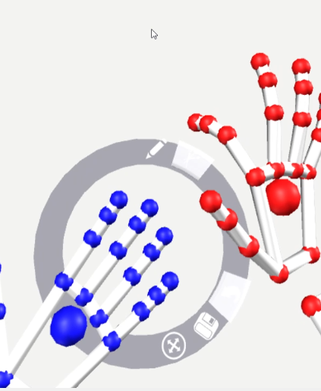
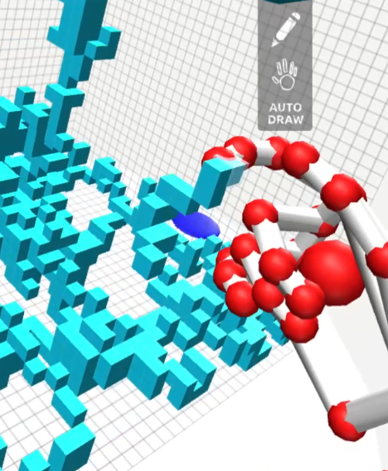
Results and Analysis
Comfort
No reported VR sickness
High enjoyment
Pinch Drawing
Pinch detection was too sensitive
Accidental edits
UI
Menu was difficult to use
HUD was not very effective
Figure 19 the UI menu and accidental drawing
Notes:
In terms of comfort, there was no vr sickness reported, people were generally comfortable. It was a bit warm in the lab some days so some people felt a bit sweaty afterwards. One participant said hiss back was a bit sore after, but wasn’t sure if that was because he was a bit tall for the configuration or just generally standing to work.
The pilnch drawing was too sensitive for pretty much everybody. There were a lot of accidental edits and a lot of Undo button clicking.
The UI needs a lot of work. The users had trouble clicking the top buttons.
The HUD also wasn’t too effective, I found myself having to point out to people occasionally that they were in delete mode when they didn’t mean to be, things like that

Slide 27
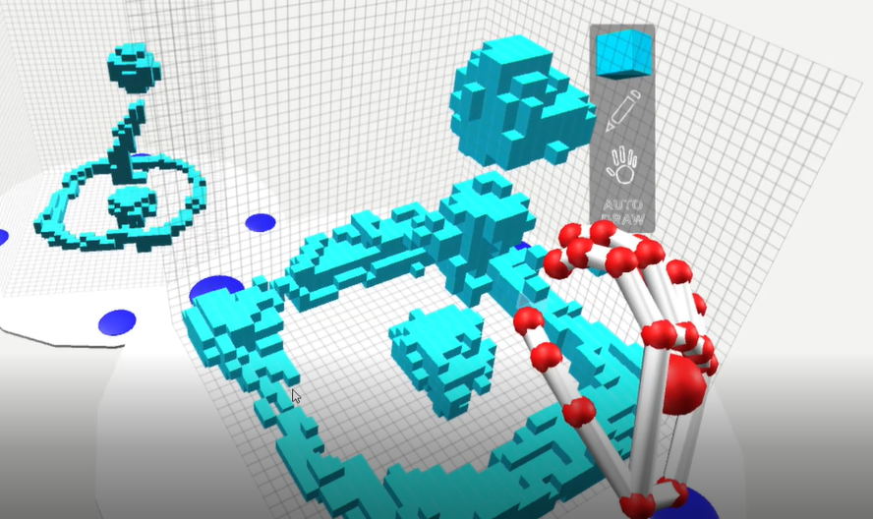
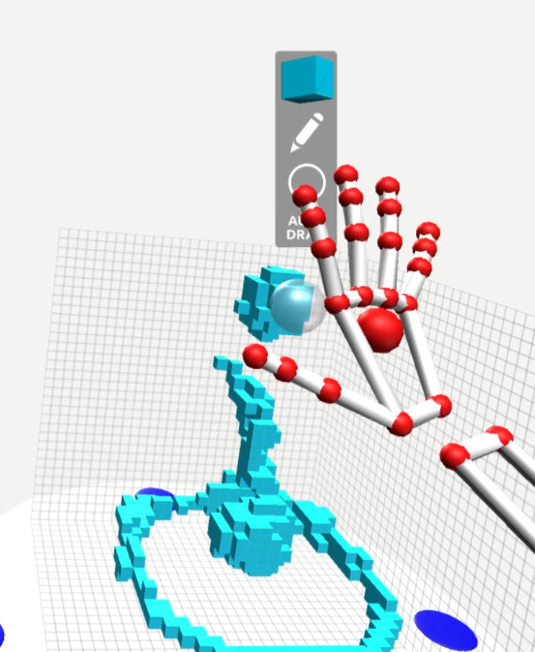
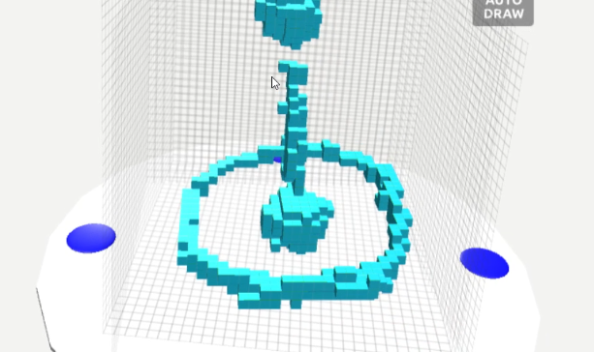
Results and Analysis
Drawing Techniques
Brushes
Drawing thick strokes and chipping away
Attempted to overlay reference model on drawing platform
Figure 20 Chipping away at thick strokes (top), overlaying (bottom), using a brush (right)
Notes:
A few users tried the brushes, the whole thing could use pinch drawing. Some users tried creating the two sort of spherical shpaes with either the sphere or the cube brush, others tried drawing with the pen brushes
A few users tried making thick strokes and then chipping away at them
And a few also tried overlaying the reference model right inside their drawing canvas

Slide 28
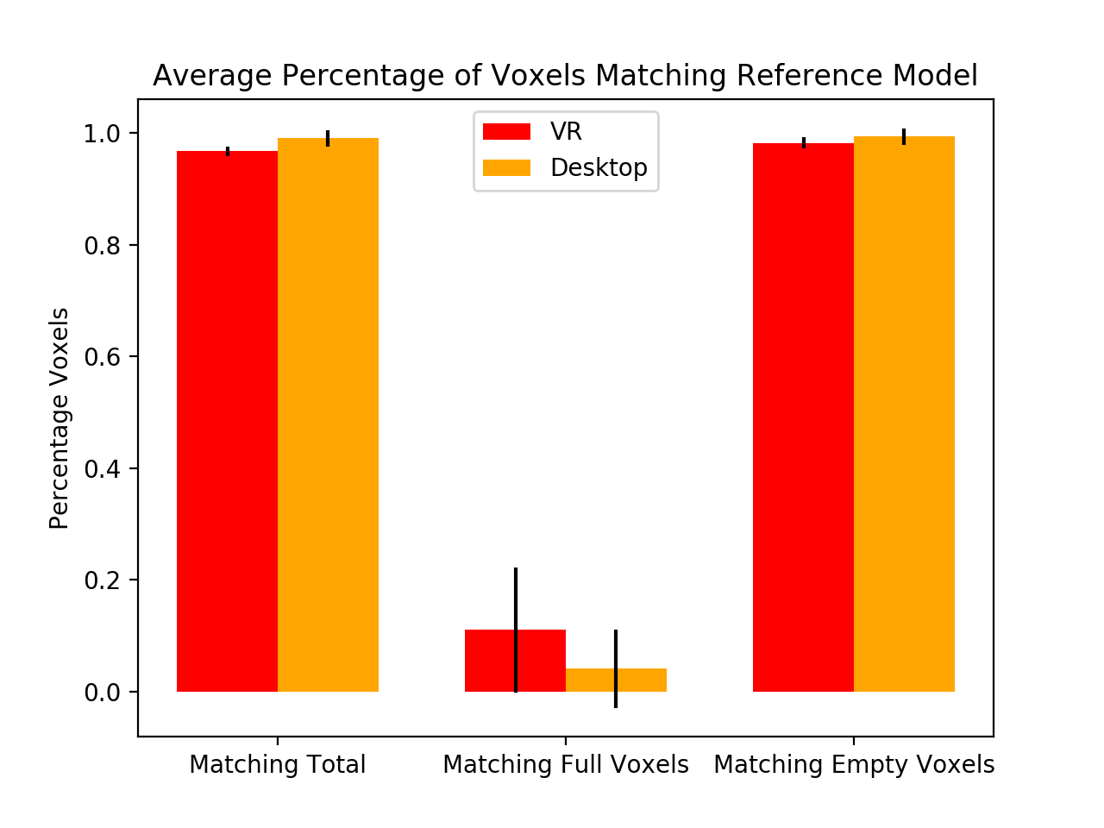
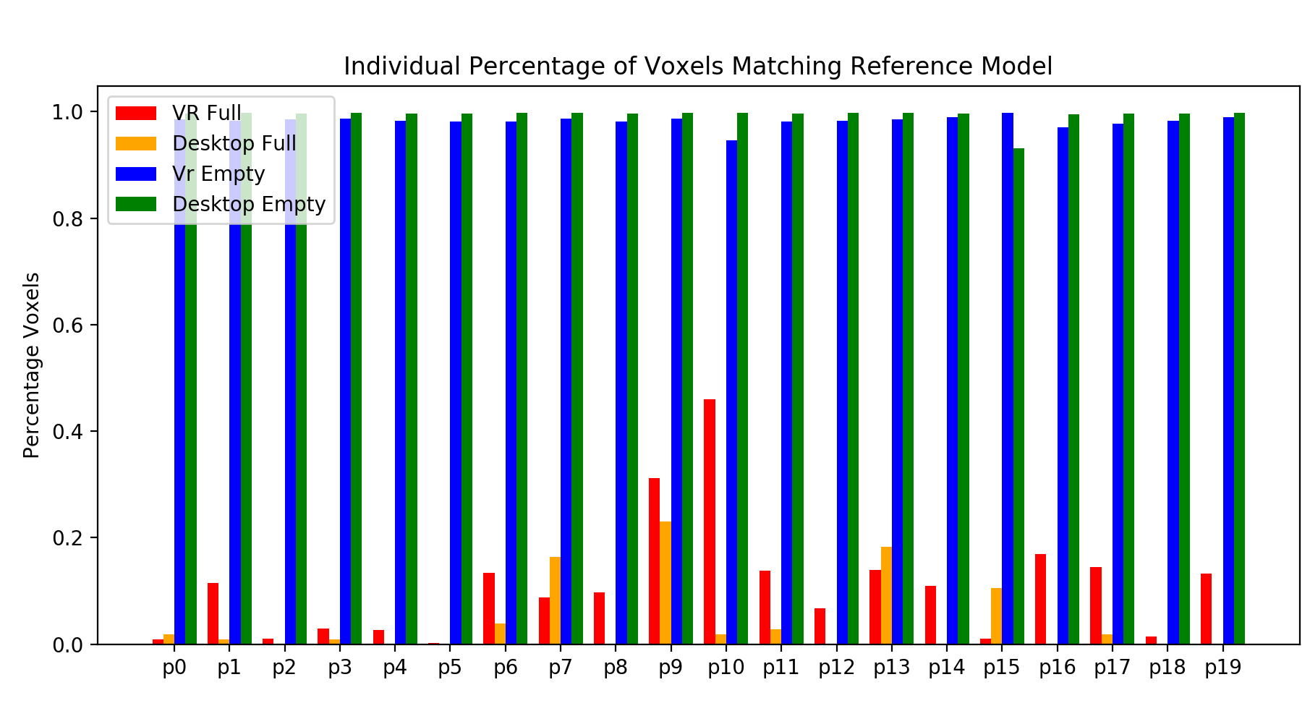
Results and Analysis
Model Analysis
Voxel to voxel comparison
Reference model was mostly empty voxels
Users placed an average of 65.6 full voxels correctly in VR and 4.3 in Desktop
Figure 21 and 22 voxel to voxel comparisons
Notes:
In terms of voxel to voxel comparison, because the reference models are mostly empty voxels, it is easy to get a high percentage of matches as long as you draw something that’s mostly empty. So, I broke this down into empty, full, and total matches. Full voxel matches were very low, espetially in the keyboard model because there are so few actual full voxels, and it is easy to shift a drawing slightly.
A few participants got a lot of full voxel matches, but only because those users drew thick strokes that emcompassed all of the correct full spaces

Slide 29
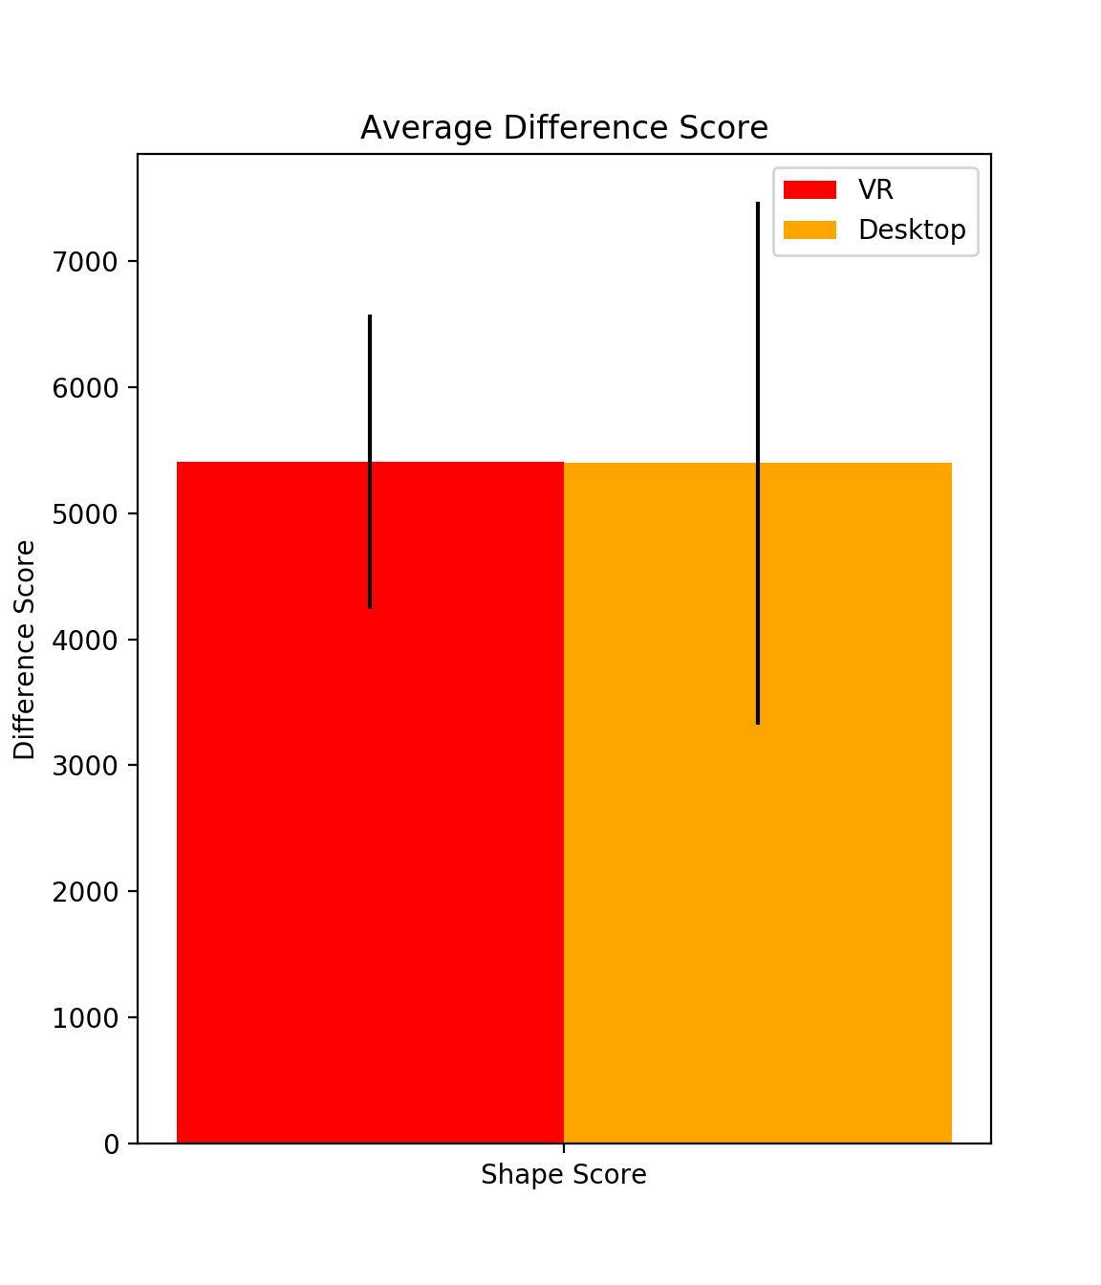
Results and Analysis
Model Analysis
Shape dissimilarity
Averages nearly the same
5406.4 for VR and 5398.35 for desktop
VR model had an 807.6 difference in dissimilarity score
while the average for better desktop models was 815.65
Figure 23 average voxel model shape dissimilarity scores
Notes:
Now we’ll look at the dissimilarity scores.
The average dissimilarity score for VR was only slightly higher than the dissimilarity for desktop. Which was unexpected. But you can see there’s a lot more deviation in the desktop version.

Slide 30
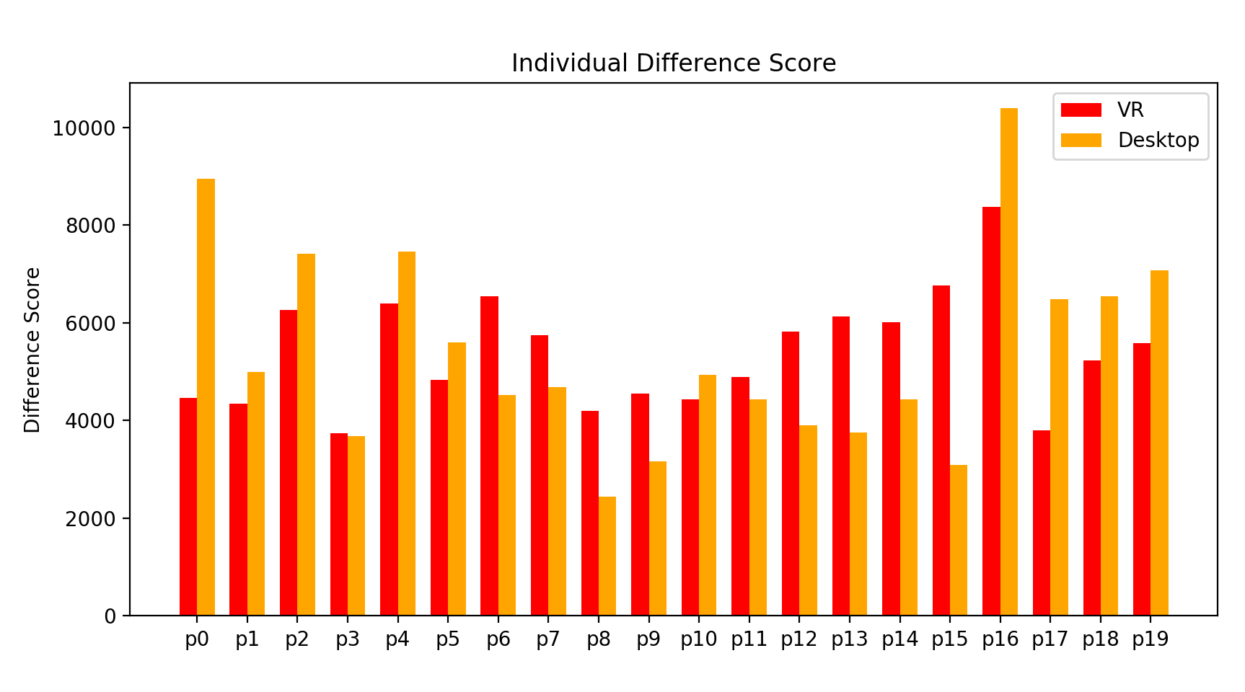
Results and Analysis
Dissimilarity for all users
Figure 24 Individual dissimilarity scores
Notes:
And this is the dissimilarity for each user individually. And it does appear that for most, their scores do tend to line up together
The average difference for better vr models and better keyboard models were both about 800

Slide 31
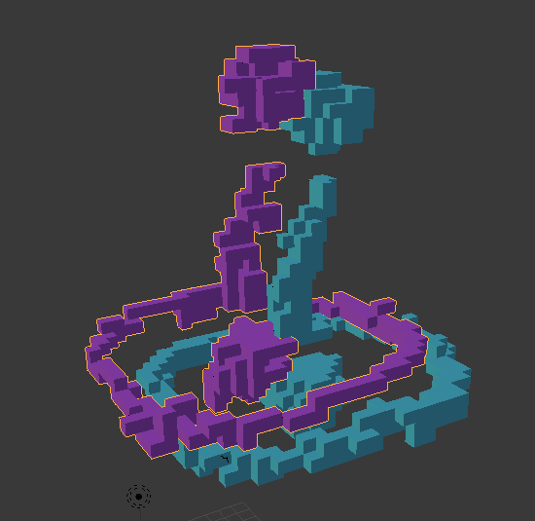
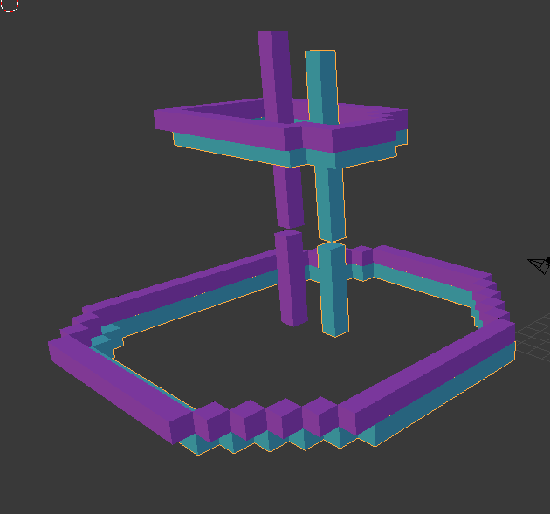
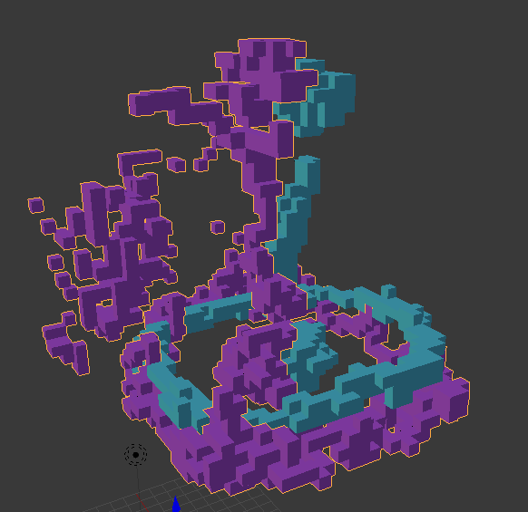
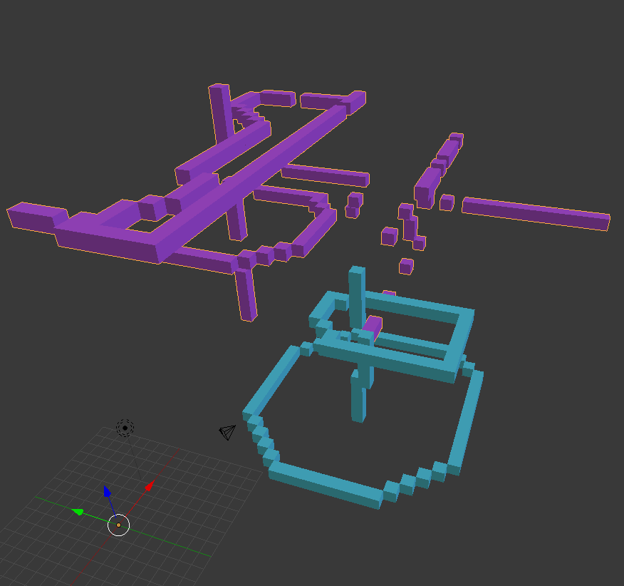
Results and Analysis
The models with lowest and highest dissimilarity scores
Notes:
These are the models that, on top had the lowest dissimilarity and the ones on the bottom had the highest dissimilarity, with purple being the user’s models and blue being the reference models

Slide 32
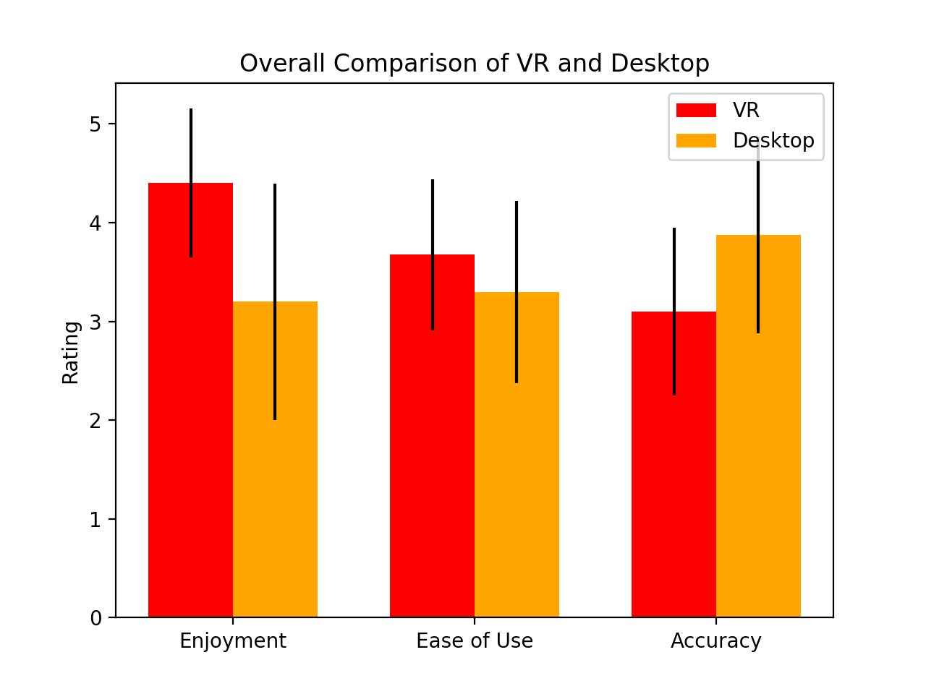
Results and Analysis
Questionnaire
Version comparison
VR was more enjoyable
VR was a little easier to use
Desktop accuracy was much better
Figure 25 version comparison
Notes:
First, we took questionnaire categories and used them to compare the versions
VR was more enjoyable overall
Vr was slightly easier to use, but those responses were not significantly different
And desktop was significantly more accurate

Slide 33
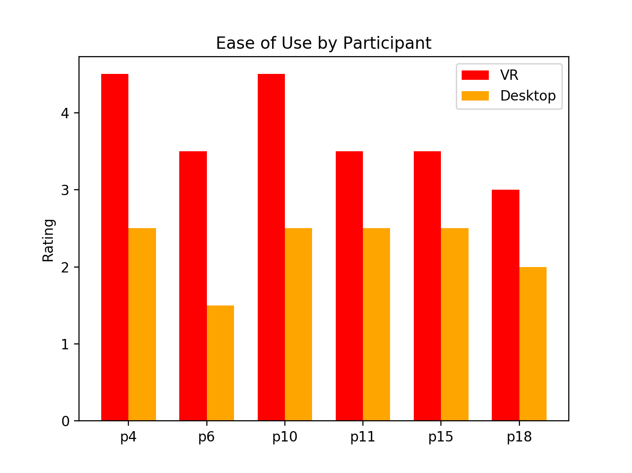
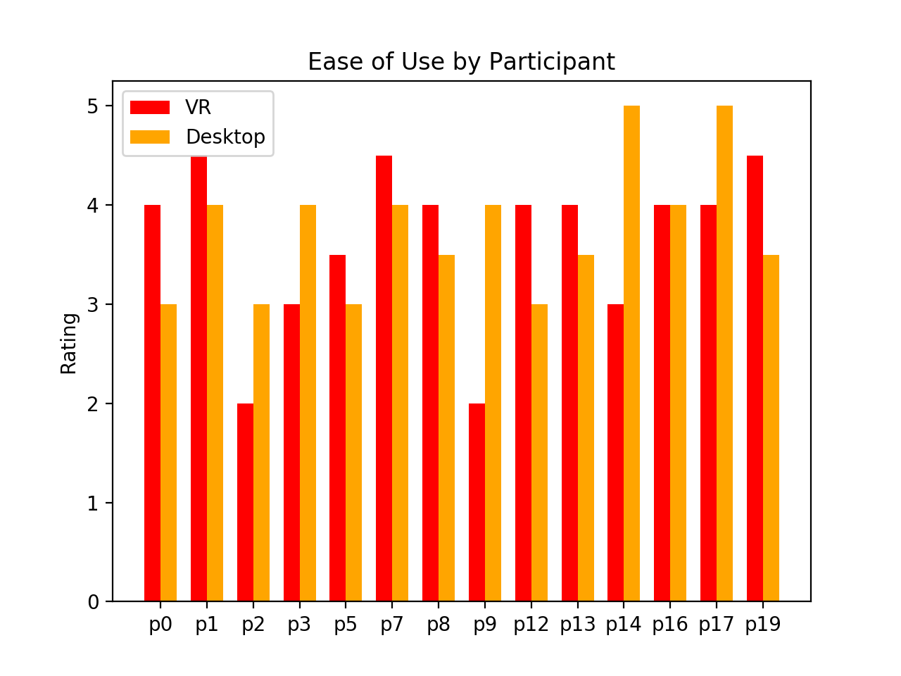
Results and Analysis
Users who rate the desktop version difficult to use always rated the VR version’s ease of use as 3 or above
Users who rated the desktop version easy to use were more mixed
Figure 26 ease of use by participants who rated desktop poorly (top) and those who did not (bottom)
Notes:
When we break down the ease of use by participant, six users rated the desktop version as difficult to use, averaging 2.5 or below (3 for each question was neutral), but interestingly all six of those users rated the vr app as 3 or above. Also interestingly only two users overlap between this one and the ones who were noticeably struggling with keyboard that I mentioned earlier.
For the rest of the users, the responses are more varried

Slide 34
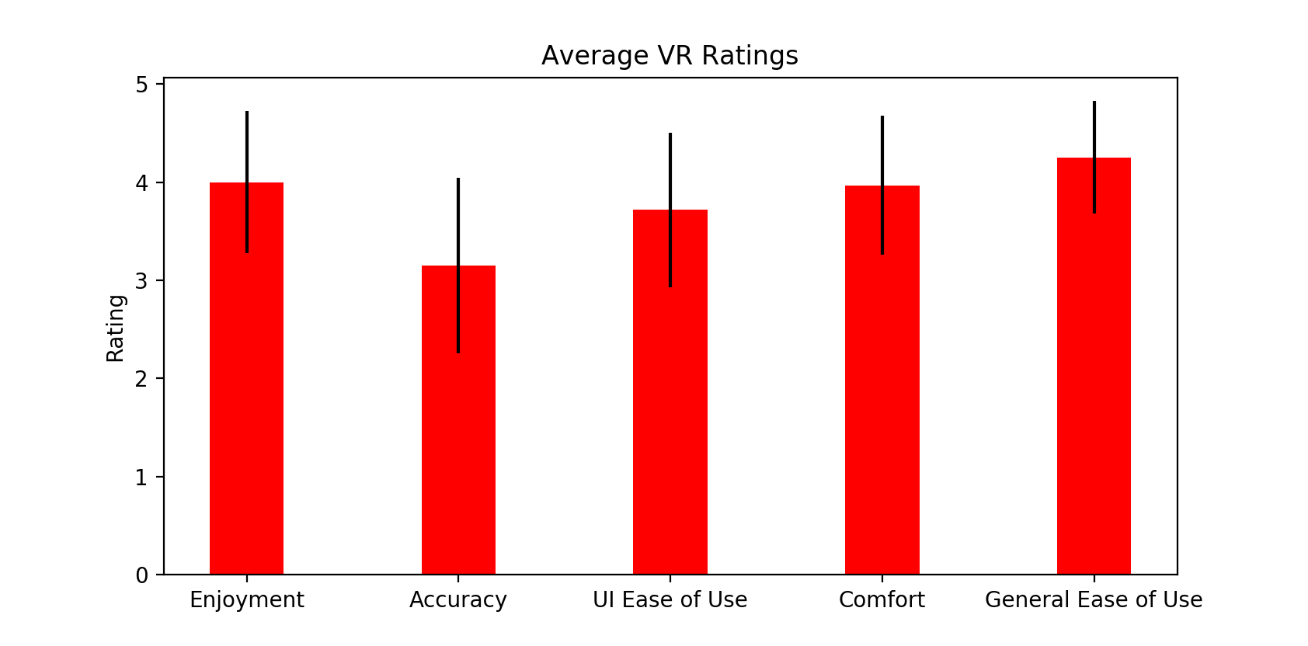
Results and Analysis
Detailed VR ratings
Accuracy needs improvement
Most ease of use issues were with the hand-held menu
Very little arm fatigue, although one user noted his back was a bit sore after
Figure 27 detailed VR ratings (1 being strongly disagree, 5 strongly agree)
Notes:
So here’s a more detailed look at the vr ratings
Accuracy definitely needs improvement
The ease of use was most negatively affected by the ui hand menu
There was very little arm fatigue, most uses rated that as disagree or strongly disagree, which was reversed for reporting

Slide 35
Results and Analysis
Comments
Users liked accuracy and simplicity of the desktop app, but wanted more control over platforms and better depth cues
Users liked the overall VR experience, “Being in a computer world was amazing”
Feature Requests
Redo button
Better accuracy and bigger menu buttons
Ability to move full voxels after drawing them
Visual overlays or colors to help differentiate voxels and reference model
Transparent drawing platform
A more natural position for the pen brush

Slide 36
CONCLUSIONS AND RECOMMENDATIONS
Models were slightly more accurate using the desktop application, except for participants who were unfamiliar with the keyboard control scheme
participants enjoyed the VR application, but found the accuracy and some controls lacking
the desktop version of the application did not necessarily provide an easy test for drawing ability for all users
VR and mid-air hand tracking may offer an easier path to digital art and design than traditional applications for users who are not already accustomed to traditional desktop control schemes
Notes:
First, models were slightly more accurate in desktop except for that group who struggled with the desktop app
Participants enjoyed vr app more

Slide 37
CONCLUSIONS AND RECOMMENDATIONS
Interaction Improvements
Flat buttons might be replaced with cubes or spheres, larger and further apart
Buttons should not be placed around the fingertips
The hand-held menu should be accessed infrequently
Voice commands
Adjust pinch drawing with delay and lower sensitivity
An outer control circle on platform that moves in a physics-based manner
Customize Leap Motion hands to prevent occlusion

Slide 38
CONCLUSIONS AND RECOMMENDATIONS
Interaction Improvements
Preview voxels and outline indicators
Selecting and moving voxels
Isolate portions of a model for viewing
Pressure sensitivity

Slide 39
CONCLUSIONS AND RECOMMENDATIONS
Tutorial Improvements
Buttons were difficult to operate
Should use full body animated demonstration
Should create a user profile that tailors gesture detection to user

Slide 40
CONCLUSIONS AND RECOMMENDATIONS
Limitations
“Demand Characteristic” [14]
Disabled features
Differences in reference models
Some more background questions such as desktop gaming experience may have helped

Slide 41
Questions?

Slide 42
References
‘Leap Motion”, Leap Motion, 2018. [Online]. Available: https://www.leapmotion.com/ [Accessed: 07-Jul-2018].
A. Colgan, “How Does the Leap Motion Controller Work?,” Leap Motion Blog, 18-Jan-2017. [Online]. Available: http://blog.leapmotion.com/hardware-to-software-how-does-the-leap-motion-controller-work/. [Accessed: 07-Jul-2018].
J. Boritz and K. S. Booth. “A study of interactive 3D point location in a computer simulated virtual environment”. 1997. In Proceedings of the ACM symposium on Virtual reality software and technology (VRST '97). ACM, New York, NY, USA, 181-187. DOI=http://dx.doi.org/10.1145/261135.261168
R. Aigner, D. Wigdor, H. Benko, M. Haller, D. Lindbauer, A. Ion, S. Zhao, J. Koh, "Understanding Mid-Air Hand Gestures: A Study of Human Preferences in Usage of Gesture Types for HCI," Microsoft Research Technical Report MSR-TR-2012-111, Nov. 2012. [Online]. Available: https://www.microsoft.com/en-us/research/publication/understanding-mid-air-hand-gestures-a-study-of-human-preferences-in-usage-of-gesture-types-for-hci/ [Accessed on: July 1, 2018].
J. Cui, A. Kuijper and A. Sourin. "Exploration of Natural Free-Hand Interaction for Shape Modeling Using Leap Motion Controller". 2016 International Conference on Cyberworlds (CW), Chongqing, 2016, pp. 41-48. doi: 10.1109/CW.2016.14

Slide 43
References
J. Cui and A. Sourin. “Interactive shape modeling using leap motion controller”. 2017. In SIGGRAPH Asia 2017 Technical Briefs (SA '17). ACM, New York, NY, USA, Article 3, 4 pages. DOI: https://doi.org/10.1145/3145749.3149437
T. Oe, B. Shizuki, and J. Tanaka. “ Scan modeling: 3d modeling techniques using cross section of a shape”. 2012. In Proceedings of the 10th Asia pacific conference on Computer Human Interaction (APCHI '12). ACM, New York, NY, USA, 243-250. DOI: https://doi.org/10.1145/2350046.2350096
T. Grossman, R. Balakrishnan, G. Kurtenbach, G. Fitzmaurice, A. Khan, and B. Buxton. “Interaction techniques for 3D modeling on large displays”. 2001. In Proceedings of the 2001 Symposium on Interactive 3D graphics (I3D '01). ACM, New York, NY, USA, 17-23. DOI=http://dx.doi.org/10.1145/364338.364341
T. Igarashi, J. F. Hughes. “A suggestive interface for 3D drawing”. 2006. In ACM SIGGRAPH 2006 Courses (SIGGRAPH '06). ACM, New York, NY, USA, Article 10 . DOI: https://doi.org/10.1145/1185657.1185771
”Orion Beta”. Leap Motion / Developer. 2017 [Online]. Available: https://developer.leapmotion.com/orion/. [Accessed: 07-Jul-2018].

Slide 44
References
A. Stavrinou. “Unity Voxel Tutorial Part 1: Generating Meshes from Code,” Student Game Dev, 2013. [Online]. Available: http://studentgamedev.blogspot.com/2013/08/unity-voxel-tutorial-part-1-generating.html. [Accessed: 07-Jul-2018].
S. Gordon. “Parsing Wavefront OBJ files in C#”. Stefan Gordon.com. 2015. [Online]. Available: https://www.stefangordon.com/parsing-wavefront-obj-files-in-c/. [Accessed: 07-Jul-2018].
D. Chen, X. Tian, Y. Shen and M. Ouhyoung. “ On Visual Similarity Based 3D Model Retrieval”. 2013. Computer Graphics Forum, 22: 223-232. doi:10.1111/1467-8659.00669
B. Brown, S. Reeves, and S. Sherwood. “Into the wild: challenges and opportunities for field trial methods”. 2011. In Proceedings of the SIGCHI Conference on Human Factors in Computing Systems (CHI '11). ACM, New York, NY, USA, 1657-1666. DOI: https://doi.org/10.1145/1978942.1979185

